Slide 1
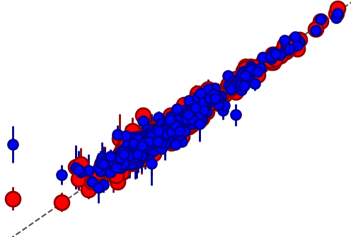
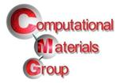

The MAterials Simulation Toolkit for Machine Learning (MAST-ML)
Ryan Jacobs, Benjamin Afflerbach, Dane Morgan
(University of Wisconsin – Madison, WI USA)
Machine Learning for Materials Research (MLMR) &
Workshop on Machine Learning Quantum Materials
https://www.nanocenter.umd.edu/events/mlmr/program/
August 2, 2018
Notes:
Add CMG logo????

Slide 2
What is MAST-ML?
MAST-ML is an open-source Python package designed to broaden and accelerate the use of machine learning in materials science research
MAST-ML:
Leverages canonical machine learning packages (e.g. scikit-learn) to enable the easy construction and execution of general machine learning analysis pipelines
Codifies best practices of in-depth statistical analysis on user-defined model assessment tests (e.g. leave out group CV)
Enables data-driven materials research on a faster scale by automating execution and assessment of analysis pipelines, particularly for non-experts

Slide 3
MAST-ML scope and capabilities
The focus of MAST-ML is currently on supervised learning problems, with emphasis on its application to materials research problems
MAST-ML supports the full library of scikit-learn modules, and is currently being extended to support tensorflow with Keras
MAST-ML allows for the simultaneous execution of an arbitrary combination of data preprocessing, feature generation/selection, model types and model evaluation metrics
MAST-ML is publicly available on GitHub (https://github.com/uw-cmg/MAST-ML/tree/dev_Ryan) (pull/download dev_Ryan branch)

Slide 4
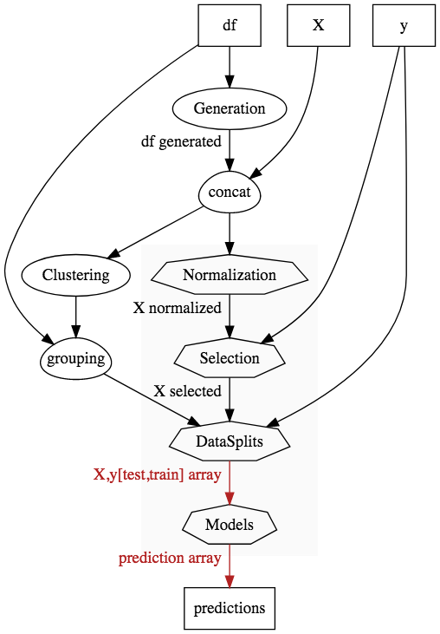
MAST-ML workflow
Data import from .csv file
Feature generation (e.g. MAGPIE, Materials Project data)
Combine generated and user-specified features
Clustering and grouping of data (e.g. by chemistry, by element)
Feature normalization and selection
Creation of data splits, e.g. random CV, grouped CV
Model fit and predict for each train/test split
Model prediction on held-out validation data

Slide 5
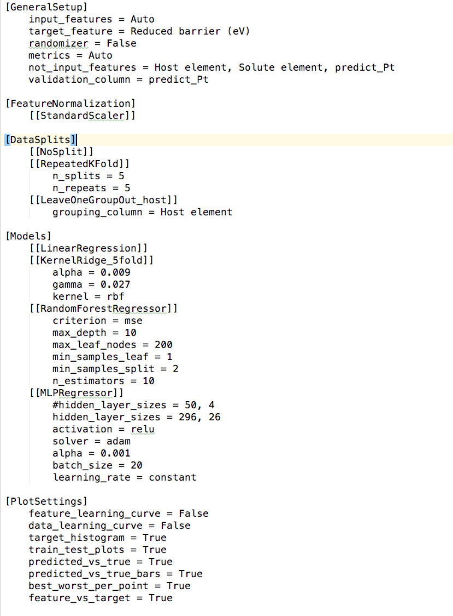
MAST-ML sample input
General setup: names of input and target features, which feature to predict on, etc.
Method to normalize features
How to split up data for testing, e.g. full fit (“NoSplit”), random CV, leave out group
Which models to test on and their associated parameters. Note that all model and parameter names are the same as in scikit-learn!
Plotting controls: decide what is output

Slide 6
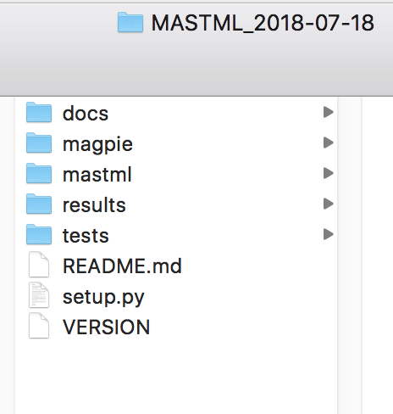
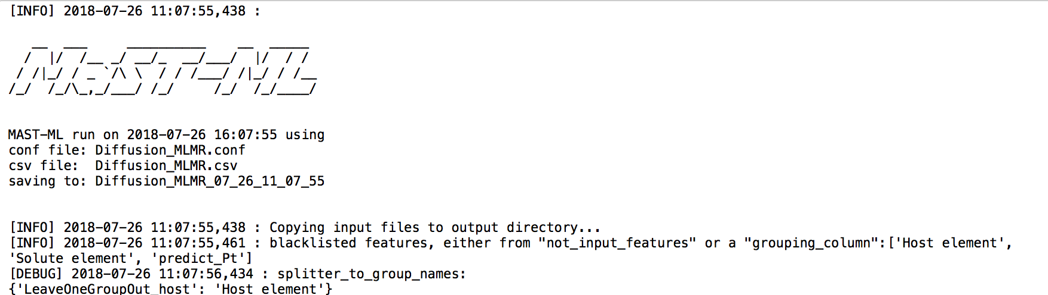
Running MAST-ML
(2) In your terminal or IDE, run the command (one line):
(1) Navigate to your main MAST-ML directory:
python3 -m mastml.mastml tests/conf/Diffusion_MLMR.conf tests/csv/Diffusion_MLMR.csv
-o results/Diffusion_MLMR
Call module
Path to input
Path to data
Path to results
(3) If it’s working, you’ll start seeing output on your screen:

Slide 7
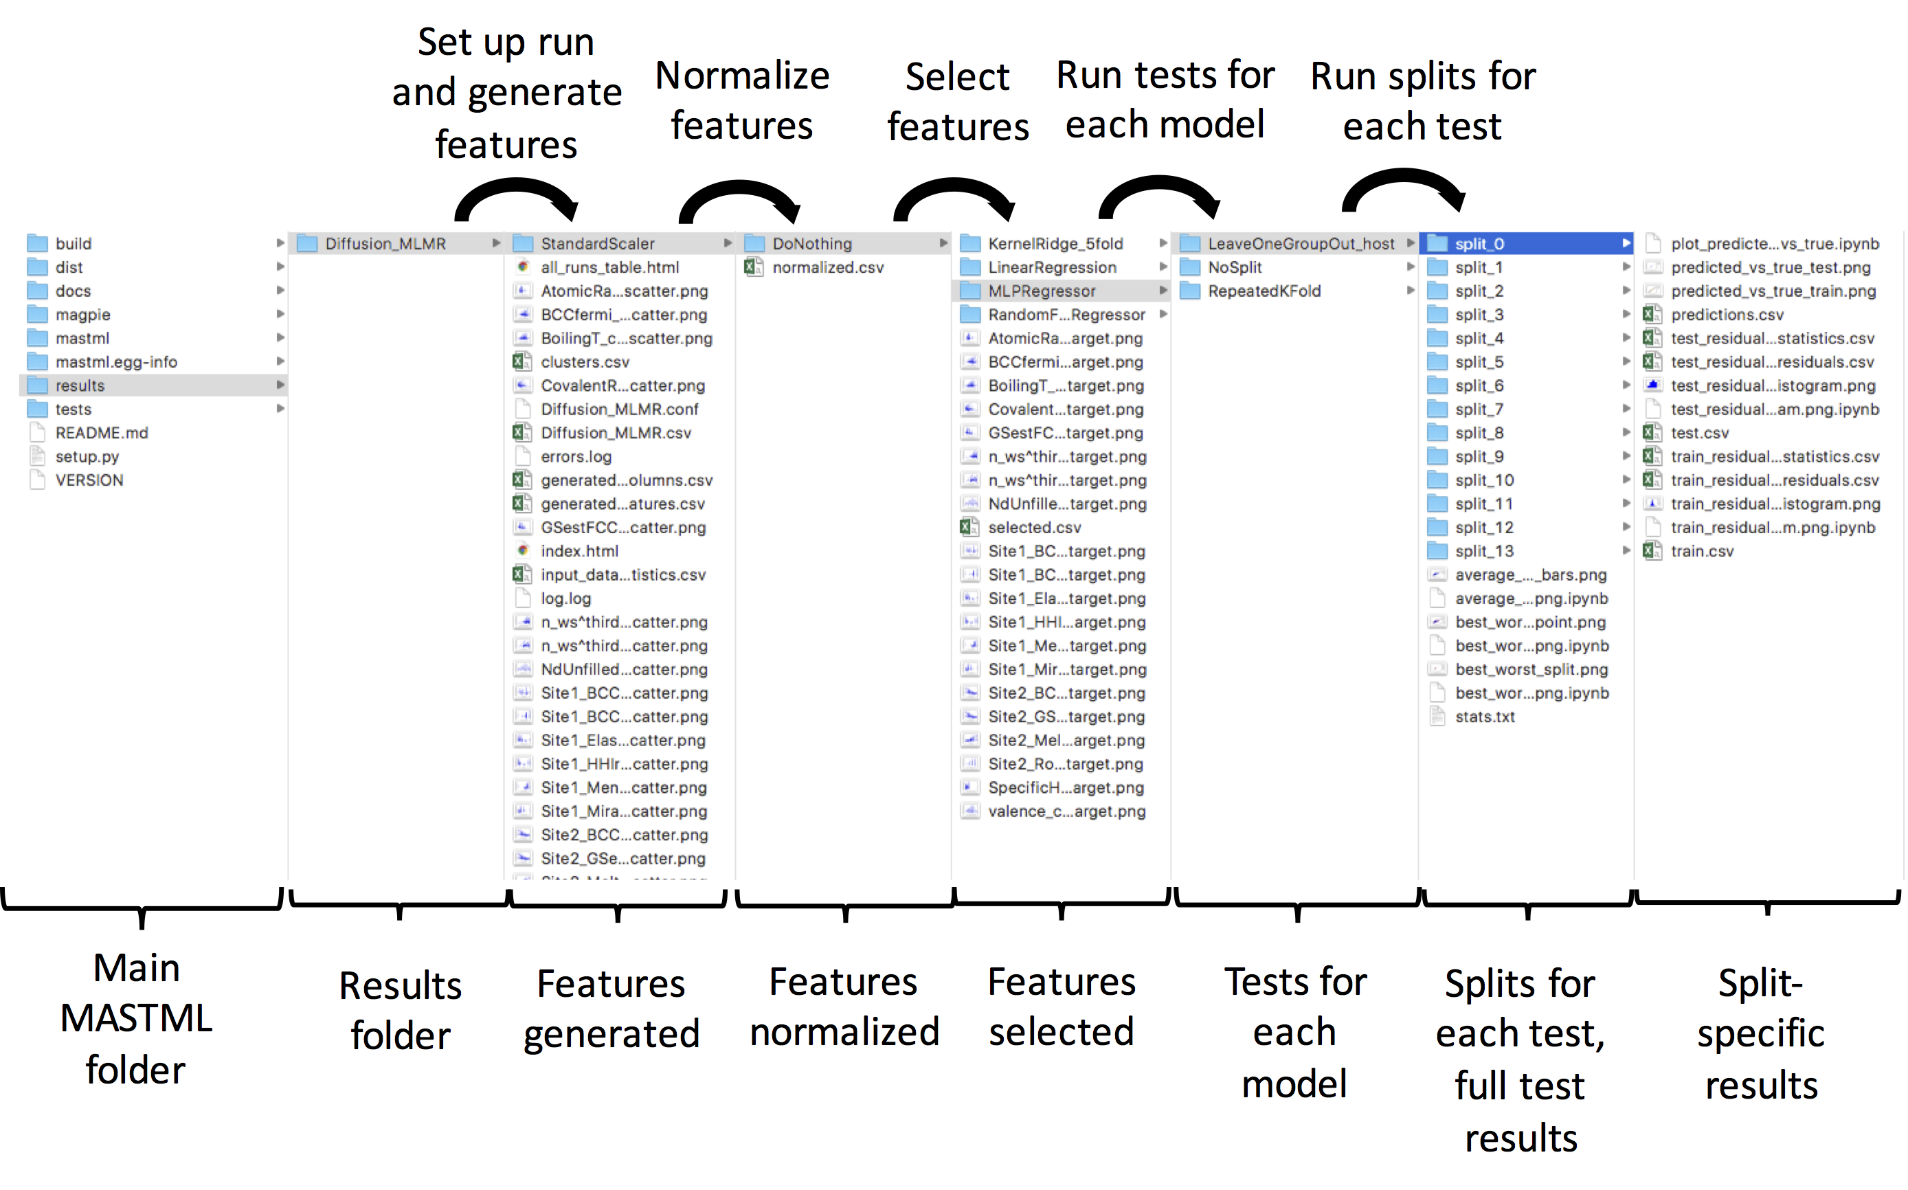
MAST-ML high-level output

Slide 8
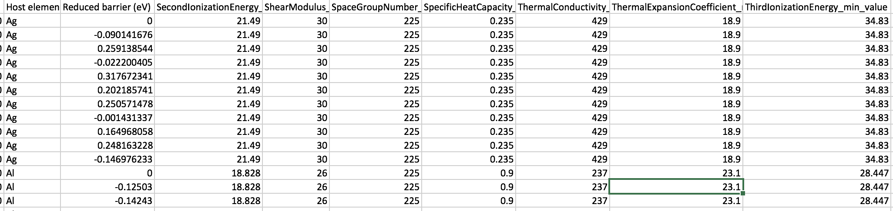
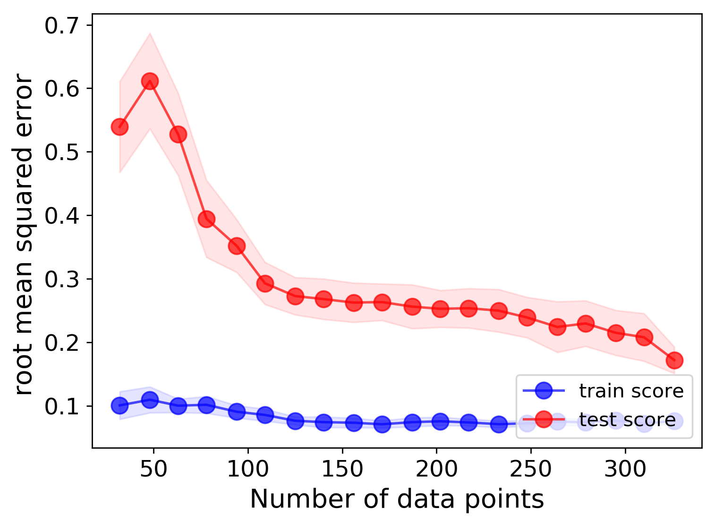
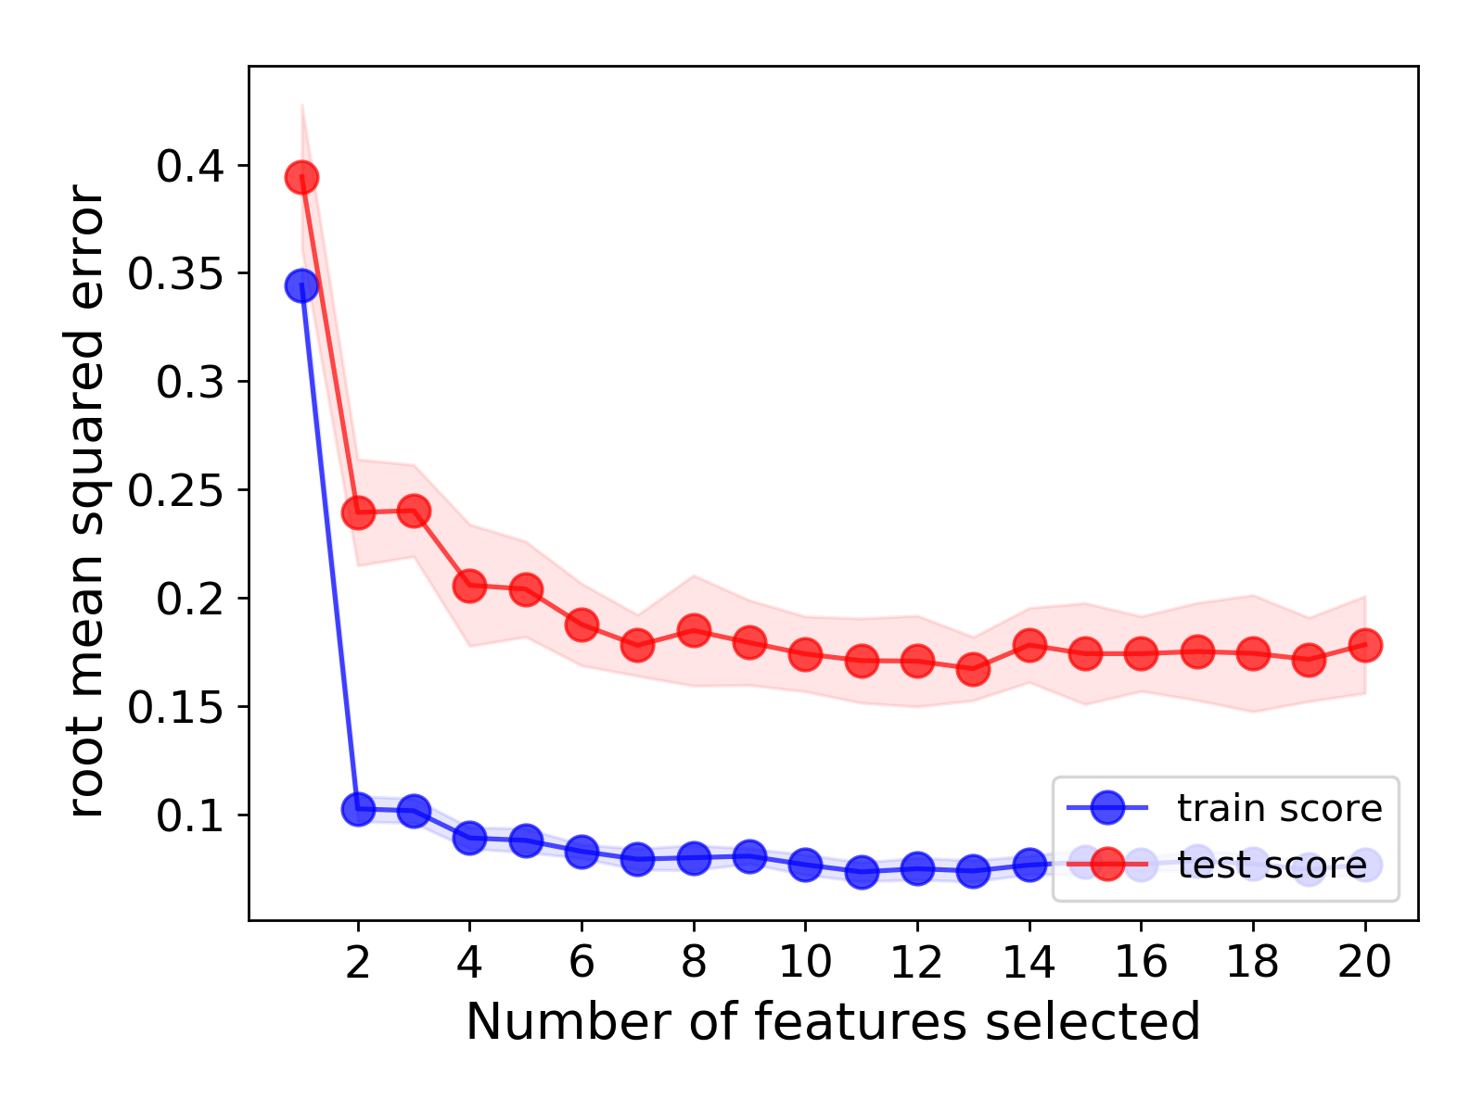
MAST-ML feature generation and selection
Generation (MAGPIE, Materials Project, Citrination)
100s or 1000s of features…
Selection and learning curves (Random Forest on Diffusion data)

Slide 9
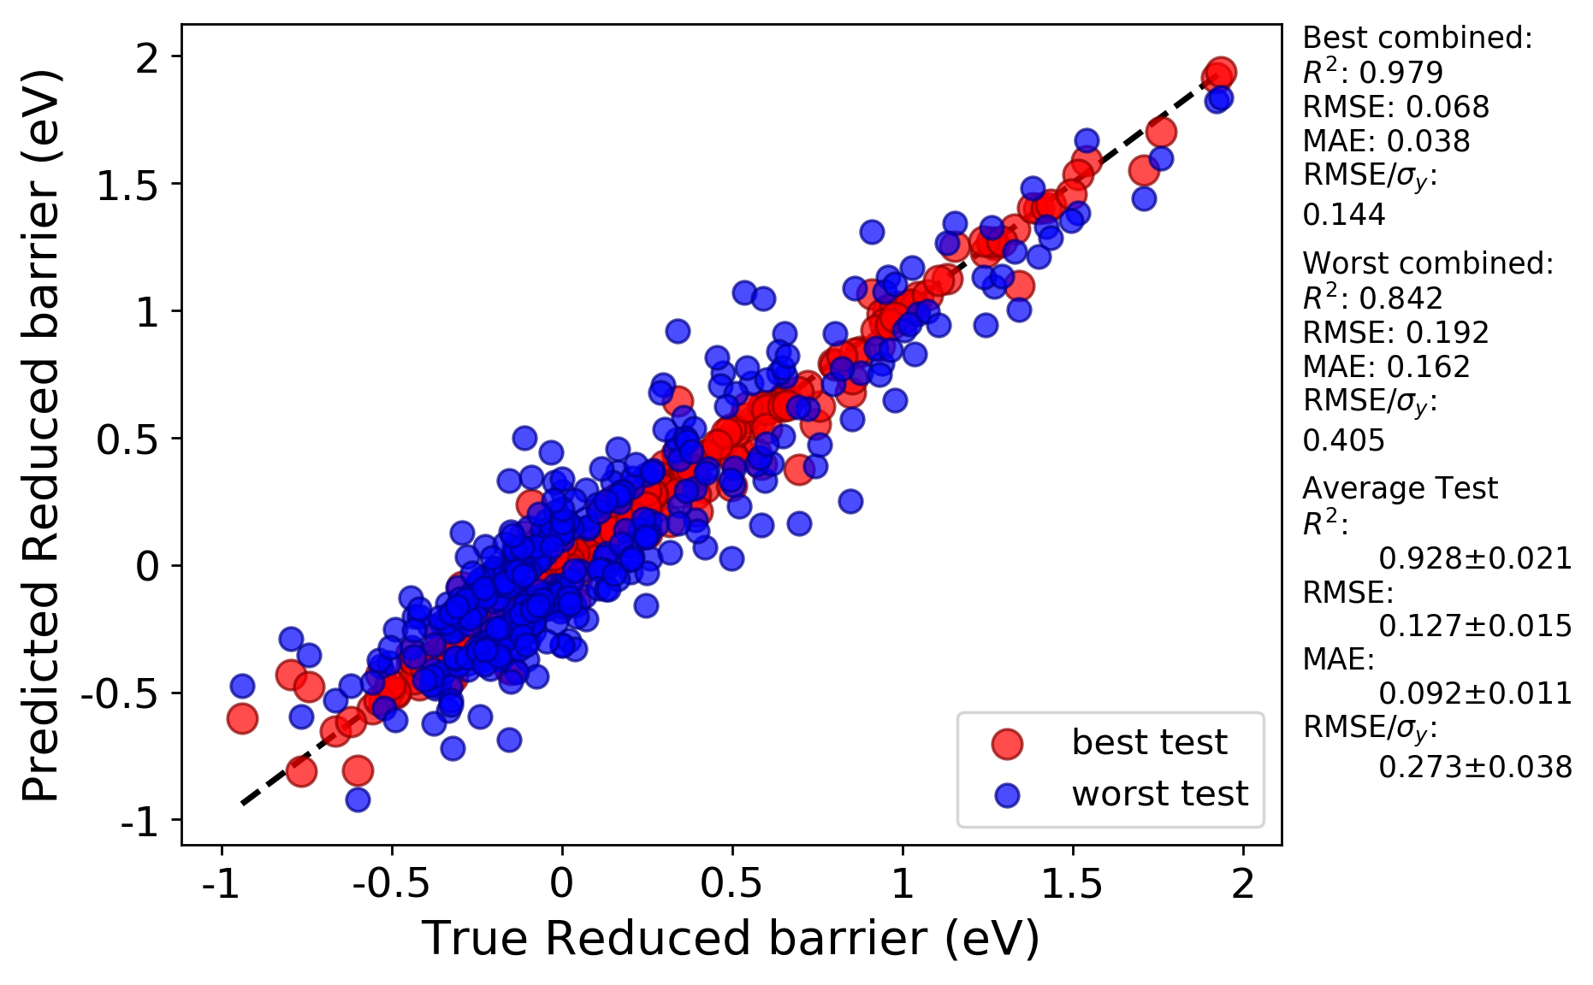
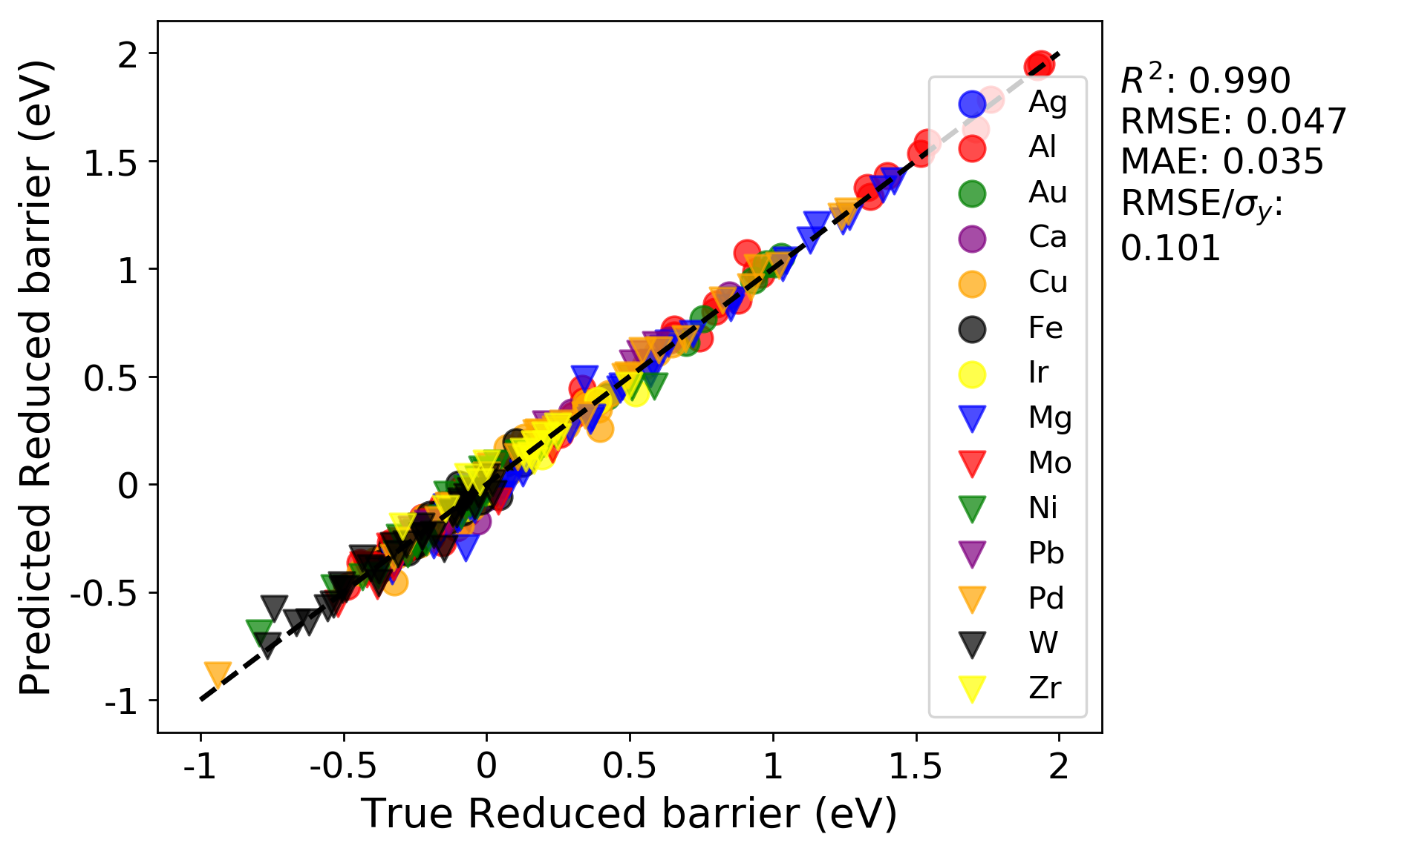
MAST-ML model assessment
A blizzard of statistics:
Output of every train/test split and prediction
Averages over every split and error bars for each point
Best/worst on per-split and per-point basis
Per-group and per-cluster train/test visualization
Output as:
Spreadsheets
Histograms
Parity/scatter plots
HTML summary file
Pt predictions:
R² = 0.93
RMSE = 0.188 eV

Slide 10
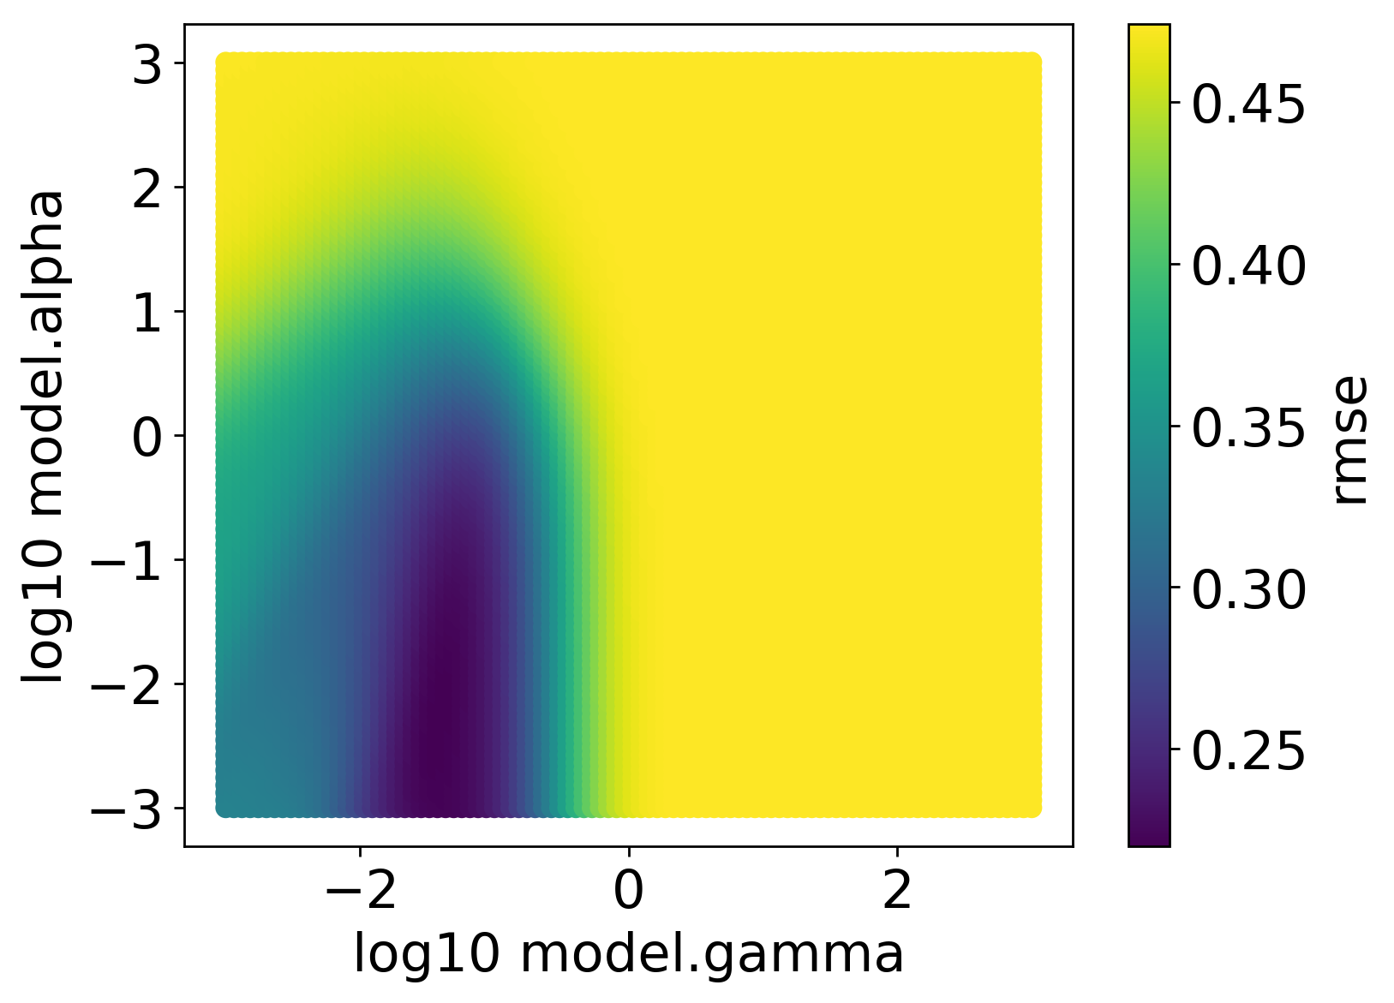
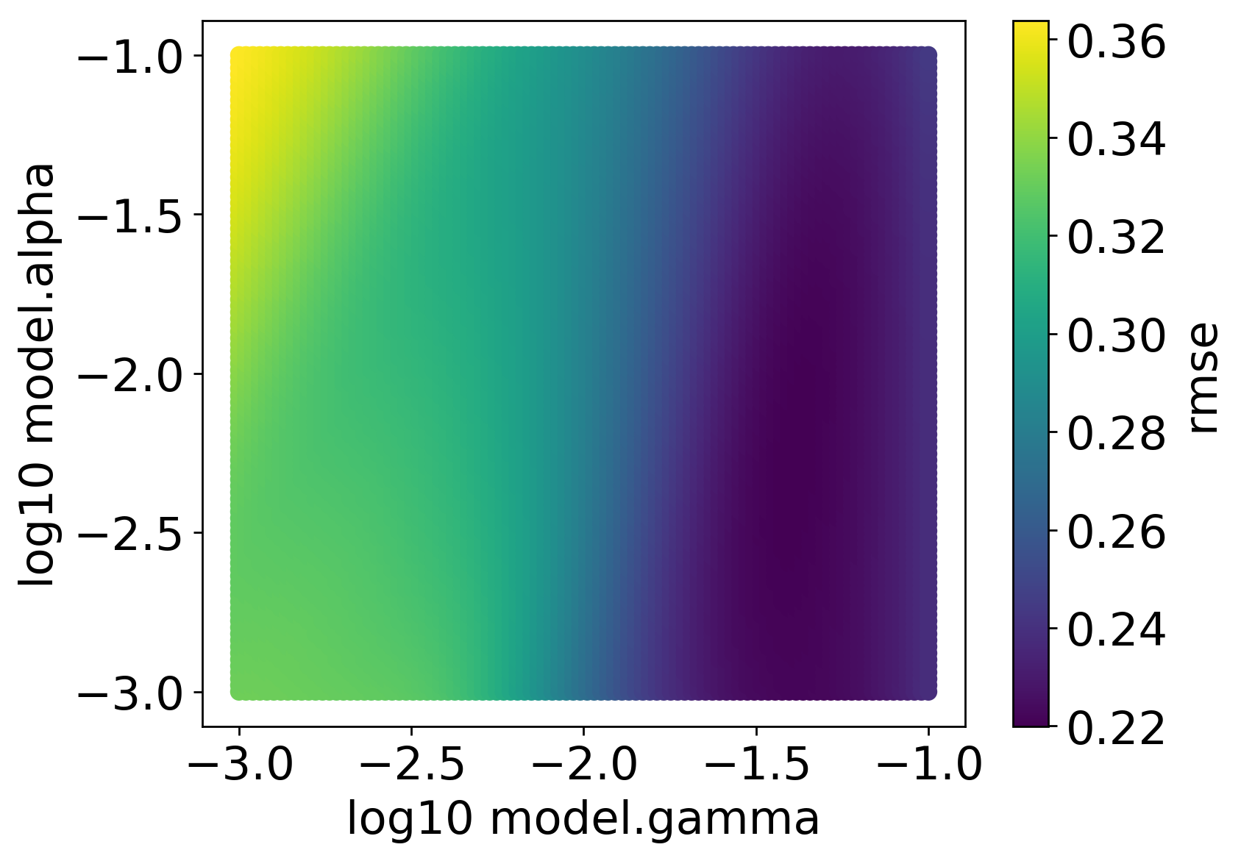
MAST-ML hyperparameter optimization
MAST-ML currently supports hyperparameter optimization using grid search and a genetic algorithm (GA). We will use GA in the lab today as it’s faster.
Example heat maps of running grid search to optimize the 𝛼 and 𝛾 parameters in a KernelRidge model on the dataset we’ll use today (numerical results also tabulated):

Slide 11
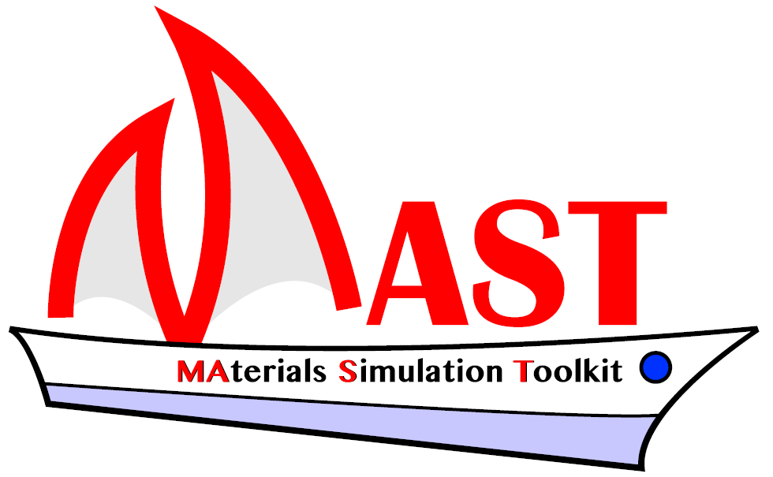
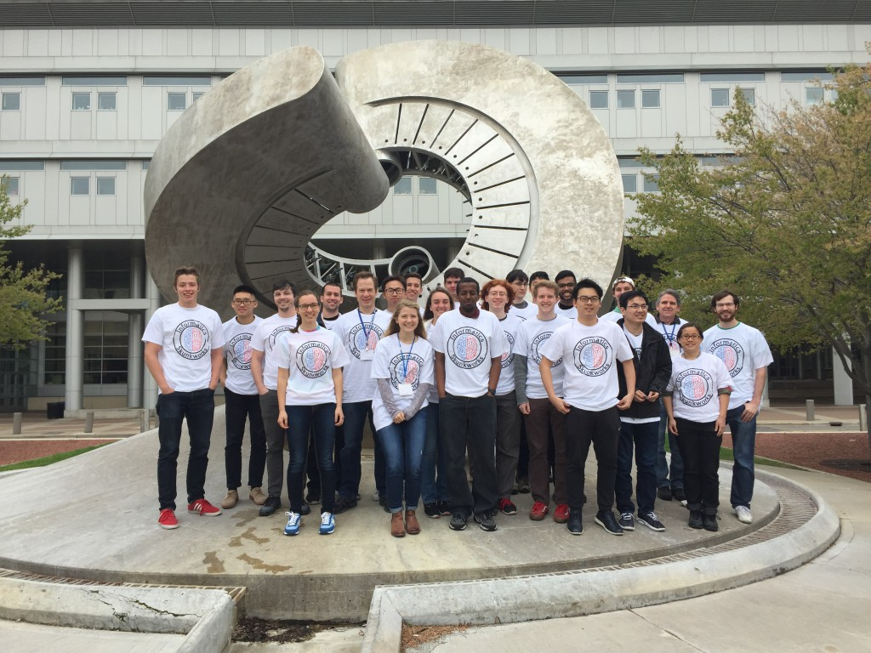
Thank You for Your Attention Any Questions?
Next up: hands-on session predicting diffusion barriers using MAST-ML
Two invitations (Dane Morgan – ddmorgan@wisc.edu)
-ML
2017-04-29
Collaboration on machine learning tools for materials science (MAST-ML)
Collaborate on undergraduate education through Informatics Skunkworks
https://github.com/uw-cmg/MAST-ML
https://skunkworks.engr.wisc.edu/
Notes:
HERE???

Slide 12
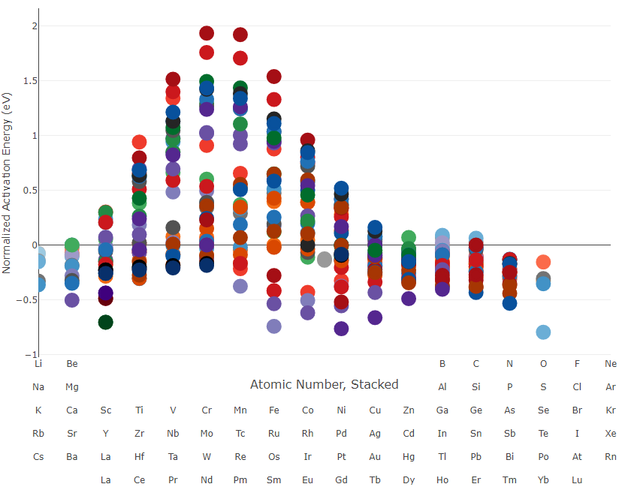
MAST-ML Hands-on Activities
Learning Objectives:
Explain how different CV schemes can change how we interpret model performance.
Use CV metrics such as RMSE and R² to choose a model type and optimize its hyperparameters.
Run the MAST-ML code package to quickly iterate through a number of ML models and CV schemes.
Solute Diffusion Dataset
DFT calculated migration energy barriers
Each datapoint is a single Solute Element diffusing in a Host Element
15 Host Elements
Average 27 Solute elements per Host, for total of 409 data points

Slide 13
MAST-ML Hands-on Activities
Installing MAST-ML
If you don’t already have the provided zip file MASTML_code_MLMR.zip with the code download from: https://drive.google.com/drive/folders/1NNducZ1kOoMQYlKz7qye2Oc7RsXiUVew?usp=sharing
Unzip into a local directory and open a terminal in the resulting MASTML_code_MLMR/ directory
Use the command: python setup.py install to install any dependencies that may be missing. For Windows users if you encounter an error relating to Visual C++ try using this alternative install command which can be found in the README.md file as well: pip install --index-url https://test.pypi.org/simple/ --extra-index-url https://pypi.org/simple mastml
First Run
From the base install directory you can use the following command to start running a pre-configured input file that will run through the first section of the Activity: python -m mastml.mastml tests/conf/Diffusion_MLMR.conf tests/csv/Diffusion_MLMR.csv -o results/Diffusion_MLMR
Refer to the Word document for further instructions on the activity and flag us down if there’s any confusion!

